Slide 1
After the Reform Era A Path Forward for Academic Support Pedagogy
Norman A. Stahl
TASS 2019

Slide 2
2005 to 2019
REFORM in Higher Education
Notes:
So let’s get serious. The reform movement in higher education did not start yesterday. In fact I believe that some of its roots are tied to the mindshift that began during the great recession as economic issues and that began with the focus on K-20 education from a global perspective.

Slide 3
The Calliope of Reform Era Movements
Pathways
Accelerated Learning Program
Integrated Education and Training
Coaching
AB 705
15 to Finish
Badges
Multiple Measures
Apprenticeships
Notes:
In the CLADEA organizations we often think that the reforms are targeted at developmental education. That is true but it was but low hanging fruit….an avenue of entry to a far greater endeavor

Slide 4
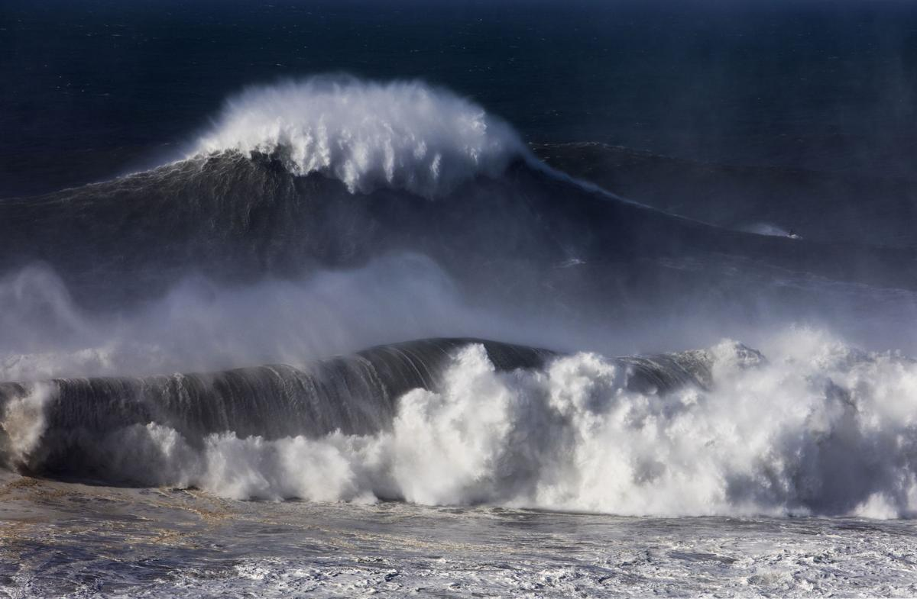

Slide 5
Call it a Rogue Wave, a Tidal Wave, or a Tsunami of change… It does not matter.

Slide 6
Professionals in the Fields of Developmental Education and Learning Assistance had two choices

Slide 7
Dude…Catch that wave

Slide 8
Developmental Education adopted a stance of denial. How did that work out?

Slide 9
NARDSPE to NADE to NOSS

Slide 10
As NARDSPE morphed into NADE, the philosophical focus was to be developmental education, but across the years the models adopted actually built upon the remedial education. Hence, there emerged a situation where the definition of developmental simply became remedial in reality and in the eyes of the higher education community. True developmental education as a philosophy was replaced by developmental studies which was an administrative scheme.
Notes:
NOSS should never have given up the remedial mission as explicit….or developmental as explicit….

Slide 11
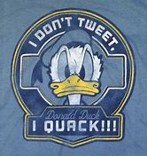
If it looks like a duck, swims like a duck, and quacks like a duck, then it probably is a duck.
Notes:
Law of absurdity
Do we have any folks trained as reading specialists here
Are you familiar with the rather old terminology from the reading field
Developmental Reading…corrective reading…remedial reading
Now let’s go to a metaphor with which you are all familar

Slide 12
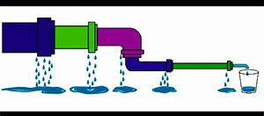
Attrition is a structural problem that can be overcome in part by policy.​ Throughout the pipeline there are multiple exit points. The more classes the student must take, the opportunities for the student to leave whether for academic performance, financial issues, or life events.​
Notes:
Fix the structure…let policy dictate pedagogy….pedagogy will automatically improve……gets past the inertia that is higher education.
The policy process that changed developmental education was but a pilot study for changing the structure of community college and technical education and perhaps in the long run higher education as a whole.

Slide 13
It Becomes Clear … For the at-risk student the pipeline leakage is a PK-16 issue. The effects of being underprepared and misprepared for the next step on the ladder is an exponential factor.​ Developmental Education has been a case of triage when it should be a case of adoption. (San Francisco State EOP model)​ Borrowed from Larry Mikulecky​
Notes:
The powers that are leading higher education reform for the most part have yet to propose PK-16 models.

Slide 14
Standards for the Developmental Education Era
Accountability (i.e., productivity)
Affordability
Access
Notes:
What’s wrong here….did we have benchmarks? In a era of reform focusing on conservative economic principles, higher education has become benchmarkcentric….and that is not all bad. So how did we change?
We were gatekeepers…that was the expectation…let them in to the school…but prove them worthy before they come to my sociology class.

Slide 15
Bottom Line: We can do better in supporting…
Persistence
Retention
Attainment
Notes:
Economics at play….. A new accountability

Slide 16
So What to Consider????
Using factors influencing the current problematic state of postsecondary reading/learning programing as a case to present four actions necessary for the preservation of the field:
Re-Defining
Re-Claiming
Re-Inventing
Re-Reforming

Slide 17
Re-Defining

Slide 18
Time to Re-Define
What is the culture of reading in a postsecondary institution?
What is the role of reading in a postsecondary institution?
Are students literate? illiterate? aliterate?
What do the professors believe? What do instructors expect? How do instructors respond?
The answers to these questions define the curriculum and instruction that is appropriate for Reading instruction (big R) in postsecondary education.
Notes:
Our GE and CTE work

Slide 19
There is nothing so practical as a good theory.
Kurt Lewin (1951). “Field Theory in Social Science: Selected Theoretical Papers”, New York : Harper
Notes:
I realize that any mention of theory at a practitioner oriented conference does present possible problems…never the less bear with me for a couple minutes

Slide 20
Lifespan Literacy Development
Alexander’s (2005, 2006) position is that we are always developing as readers and learners.
Learners require focused literacy support across their lives, not just in the primary grades. Expanding on this assumption to a specific focus on the postsecondary level is that beginning college students are faced with a number of transitions (personal, social, cultural, and academic, to name only a few), not the least significant of which is a literacy transition to the academic literacy practices and expectations of higher education (Armstrong, 2007).
Notes:
Pat Alexander presents developmental theory at its best….

Slide 21
Disciplinary Literacy
Disciplinary Literacies (DL), which focuses on the particular ways of reading, writing, thinking, and learning within various disciplines, and how learners are apprenticed into these disciplines.
Essentially, the DL premise is this: we read, write, think, learn, and communicate differently in different academic disciplines and professional fields. This is not your parent’s content area reading with generic tactics (e.g. SQ3R, Cornell notes).
(for example see Lee & Spratley, 2010; Moje, 2008; Shanahan, 2009; Shanahan & Shanahan, 2008, 2012; Shanahan, Shanahan, & Misischia, 2011; Spires, Kerkhoff, & Graham, 2016)
Notes:
We need to understand the clear difference between content field literacy and disciplinary literacy

Slide 22
Functional Contextualization
Functional context approach calls for development of a curriculum that focuses literacy on a real-world context. A functional context approach facilitates students’ learning within the instructional setting and encourages transfer of learning to situations beyond the course itself.
(see Goldberg, 1951; Roueche & Roueche, 1993; Shoemaker, 1960; Sticht, 1975a, 1975b, 1997; Sticht, Armstrong, Hickey, & Caylor, 1987)
More recently under The Workforce Innovation and Opportunity Act, Integrated Education and Training models provide literacy activities concurrently with career technical training in specific occupational clusters. (Might it be I-Best?)
(see Hirschy, Bremer, & Castellano, 2011; Zeidenberg, et al., 2010)
Notes:
Do you know Tom Sticht?
IET models…do look up on the www
Perkins

Slide 23
Re-Claiming

Slide 24
Learning Strategy Instruction
One of the highest levels of reading instruction is teaching students to be effective, efficient metacognitively aware learners.
Learning strategy courses were a staple of the reading program.
Then came the FYE movement and the ubiquitous Student Success course that across the years incorporated learning strategy instruction using a highly questionable “blind training” model or a simulation approach, both which theory and research would suggest have limited transfer value.
Action: Learning strategy course work needs to promote transfer throughout contextualization.
Notes:
Let’s explore the action item

Slide 25
It’s All About Transfer
Six different contextualization models:
a) a “blind training” model (see Brown, Campione, & Day, 1981),
b) a content field/authentic-simulation model,
c) a pull-in course model,
d) a linked-course model,
e) an embedded model, and
f) a fully contextualized model
Notes:
Std Success does contextualize to a degree when there are visits to the library, the counseling center, etc.
Simulation is removed in time and space from the actual course(s) where the transfer is needed

Slide 26
Variable Credit Courses
Now here is a scam.
Any learning to learn course should be listed in the catalog as a variable credit course from 1 to 3 credits. That way the traditional course can be offered for 3 credits or specialized 1 credit sections can be offered as adjunct courses tied to high DFW courses on campus.
Notes:
What theory does this support?

Slide 27
Re-Inventing

Slide 28
Integrated Reading and Writing as Case
Currently whether as an IRW course or as English 1A/101: Composition course with co-requisite work there is a comp-centric curricular and instructional philosophy and bias. Instruction in both reading and writing are not fully integrated. Reading serves as but a tangential element to teaching writing.
It might be postulated that the vast majority of IRW instructors across the country have an academic background in composition or even a specialization in literature with little if any comparable graduate level training in postsecondary reading theory, research, and praxis.
Notes:
Pitt….1977

Slide 29
IRW
The original rigorous BR/BW model from Pitt used co-instructors: one with advanced training in composition and one with advanced training in reading.
Action: IRW courses should be taught by individuals with academic training that crosses disciplinary borders. Curriculum and instruction should be based on a thematic, spiral curriculum. Where can you get such training?????

Slide 30
Training College Reading and Learning Specialists
A traditional degree in reading is not valued by institutions, HEAs, or accreditation agencies beyond a requirement for the now widely defunct pipeline structured remedial reading courses.
There is a need for interdisciplinary graduate programs that focus on reading, writing, and learning theory, research, and praxis. Traditional reading specialist programs and doctoral programs with a traditional PK-12 focus on reading can not adequately prepare postsecondary specialists for the current environment found across our campuses.

Slide 31
Training
Action: Students desiring to earn the master’s need to take 15 hours in composition or ESL as well as 15 hours in reading plus 6 hours in learning and curricular theory. Doctoral programs should draw upon faculty from cognitive science, reading research, composition, educational psychology, educational research, and higher education.
Ironically…those who have an academic background that integrates both reading and writing should be more hirable than composition graduates.
Notes:
SF State…

Slide 32
Adopt the Spiral Curriculum
The spiral curriculum is built upon the work of Bruner and Taba.
The model was influential to the designers of the BR/BW curriculum at the University of Pittsburgh.
The entry level reading course at NIU was designed and redesigned with a nod to this model.
So what does it look like?

Slide 33
Spiral Curriculum for Disciplinary Literacy
Each lesson/unit
approximates
disciplinary practice by:
Each lesson/unit supports building disciplinary knowledge through:
Widening of Knowledge
Deepening of Knowledge
Examining beliefs and norms
Generating questions
Texts
Designing inquiry
Tasks
Building disciplinary knowledge
Talk
Tests
Critiquing disciplinary knowledge or constructing new knowledge
Notes:
Multiple book approach…not basic skills

Slide 34
Accreditation Agencies, HEAs, and College Administrators
Reading instructors and literacy associations must advocate that those teaching or developing curriculum associated with postsecondary reading/learning pedagogy have the appropriate training and credentials.
Professional associations in the fields of developmental education, learning assistance, and reading must visibly and actively advocate to accreditation agencies, HEAs, and college administrators for professional standards for the field of postsecondary reading and learning and hence, its membership.
Notes:
Learn to be political
Have an advisory committee…who might you invite?

Slide 35
New Literacies
Pedagogy delivered to the traditional age student cohort must focus and build upon their interests, attitudes, and literacy practices. If not they will demonstrate aliterate behaviors. This requires that we all undergo professional development on an ongoing basis to be technology savvy and then incorporate the ever expanding new literacies into our curriculum and instructional practices.
Partnerships with local high schools will provide a greater understanding of the students who will be matriculating in the future.
Notes:
Know the pros and cons..know the research

Slide 36
Several Decades in a Self-Imposed Silo
Across the developmental studies era postsecondary reading specialists have stayed within the silo of basic skills instruction and generic strategy of the week instruction for decades. For too long we have been content as segregated in a gatekeeper’s silo.
With the implosion of the developmental studies movement it is time to revive our heritage of working across the campus with all departments. It is time to reach out across each campus. It is time to become an academic literacy program or a disciplinary literacy program in both name and action. (Not like the relationship developmental education had to remedial education.)
For community colleges particularly… reach out to CTE areas.
Notes:
The silo was safe…..Look at Positioning Theory

Slide 37
Co-Requisite Courses
The field has had co-requisite models in literacy going back to the 1920s at The Ohio State University.
Before the ALP models existed there were paired courses, linked courses, adjunct courses, etc. There were also peer educator models such as Supplemental Instruction, Learning Counseling, etc.
The model of co-requisite courses being employed in composition is remarkably like the ESEA Title 1 pull-out programs that evolved out of the War on Poverty.

Slide 38
Co-Reqs
Action: The historical models that support high risk general education courses (e.g. biology, psychology, chemistry) and Career Technical Education courses (e.g. nursing, engineering) need to be expanded as one credit contextualized linked or embedded courses that focus on Disciplinary Literacy and promote transfer.
Point to consider: Co-requisite models will likely become highly dependent on tutoring and embedded tutoring (if only due to economics).

Slide 39
More Options
The key is to develop course work that actually leads to college credit not just institutional credit. Strive to design courses that are seen to promote transfer, contextualization, life-long literacy, and disciplinary literacy.
Remember that a course in critical thinking is actually as much a course in critical reading. Partner with your Psych Department.
A course focused on vocabulary that uses Steven Stahl’s foundational approach is fully college appropriate.

Slide 40
And More
Learning strategy courses employing a contextualized model and targeted at unique populations may be well received (e.g. athletes, students on probation, students in “Accessability” Programs, students in targeted majors).
Consider building the rigor and outreach into a learning to learn course so that it might count for serving as an elective in meeting general education requirements.
For community college folks…If your courses do not carry transfer credit, steal the course outlines from the local public university and then submit it word for word for your curriculum approval process.

Slide 41
Re-Reforming

Slide 42
Balkanization is Not Our Friend Even with the Council of Learning Assistance and Developmental Education Associations Attempt at Confederation
ACTLA Association of Colleges for Tutoring & Learning Assistance
ACTP Association for the Coaching & Tutoring Profession
CRLA College Reading and Learning Association
NOSS National Association for Student Success
NCLCA National Learning Center Association
NCDE National center for Developmental Education
And let’s not forget the non-aligned groups
Notes:
Explain CLADEA

Slide 43
Who are the Power Brokers in 2019?
The Community College Research Center
The Center for the Analysis of Postsecondary Readiness
Carnegie Foundation for the Advancement of Teaching
California Acceleration Project
Notes:
Ties to Gates

Slide 44
Will the Playing Field Change?
Do you want to get the folks in the academic reform field upset…suggest that the reforms will eventually lead to a lessening of standards.
If such a premise turns out to be true…what are the implications for academic support?
How could that situation influence your programming?
Notes:
Need to be looking five to ten years down the road…difficult for those thinking about what to teach on Monday

Slide 45
Conduct Reality Checks
Given how much more there is to learn about the varied and context-specific literacies across any given campus, we highly encourage the use of Simpson’s “Reality Checks” (1996) or curriculum audits (Armstrong and friends: 2015a, 2015b, 2016).
Non-evaluative “Reality Checks” can also provide built-in opportunities for promoting communication across campus siloes.
Reality checks identify unknown needs across campus.

Slide 46
Reality Checks or Curriculum Audits
Reality checks are especially useful as a tool for back-mapping curriculum and instruction toward targeted and purposeful goals and scaffolding across levels.
Reality checks promote the design of curriculum and instruction that promotes lifespan literacy as the process should also be forward looking to discover the specific literacy competencies that will be expected of the students when they each enter the chosen profession.

Slide 47
Notes:
Let look at the 800 pound gorilla in the room
I hear he is doing an afternoon breakout session.
The death of 12 grade……3 year college….

Slide 48
Influence of Dual Credit Models
Dual credit will lead to enrollment shifts in traditional high enrollment gatekeeper courses on campus with possible cuts in faculty/staff/budget. Just what has happened at The Ohio State University?
As dual credit programs expand learning support services will likely shift to other courses
Dual credit programs opens opportunities to cross borders to serve a new population (AVID)

Slide 49
How are You Involved with Your Faculty Development Office?
Training for Disciplinary Literacy
Reality Checks and Curriculum Audits
Training Future Members of the Professoriate
Serving on Advisory Committees
Faculty Support Services
Text Analysis Services

Slide 50
Finally….Look for New Alliances

Slide 51
